Slide 1

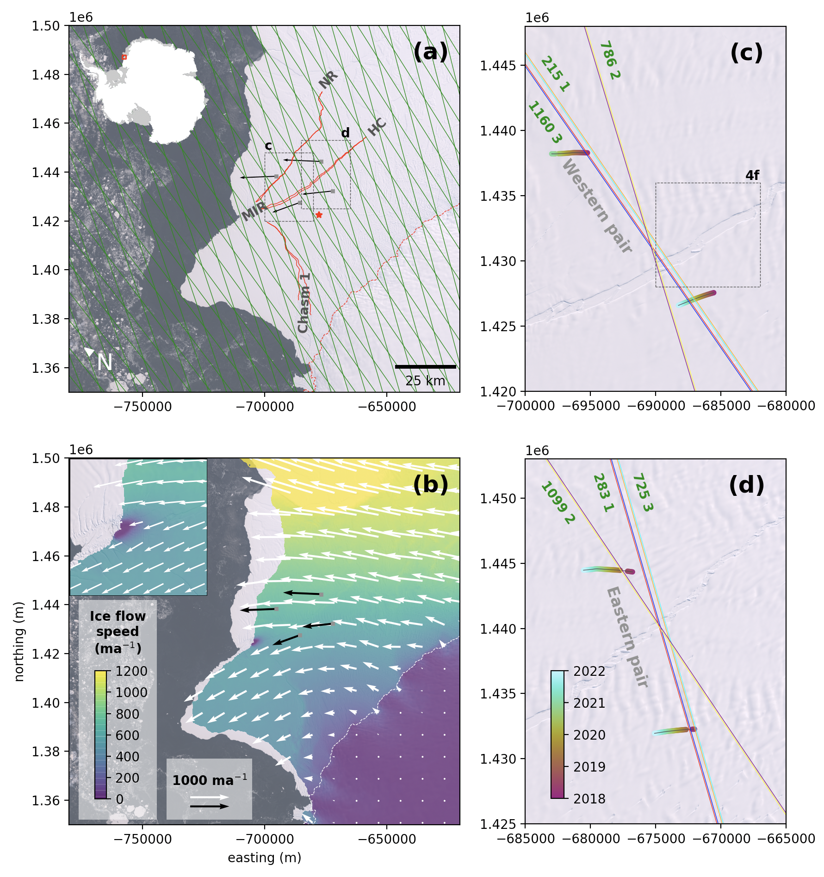

Observing iceberg calving using ICESat-2 altimetry, models and imagery
Ice shelf rifts create icebergs and can jeopardize overall marine ice sheet stability.
Low confidence in the scientific understanding of ice shelf calving processes results in uncertainties in ice sheet evolution.
ICESat-2 observations, satellite imagery and ground data were used to measure a time series of rift widths using the “Halloween Crack” on the Brunt Ice Shelf as a case study.
The study showed that shear stressed played an essential role in the evolution of the system rifts in the Brunt Ice Shelf.
The authors propose to modify widely-used ice calving laws to improve their sensitivity to the shearing mode of fracture.
Morris, A., Lipovsky, B. P., Walker, C. C., and Marsh, O. J.: Ice shelf calving due to shear stresses: observing the response of Brunt Ice Shelf and Halloween Crack to iceberg calving using ICESat-2 laser altimetry, satellite imagery, and ice flow models, The Cryosphere, 19, 4303–4325, https://doi.org/10.5194/tc-19-4303-2025, 2025.
Figure: Key glaciological features of Brunt Ice Shelf, instrument locations, and ICESat-2 ground tracks (c & d)

