Slide 1




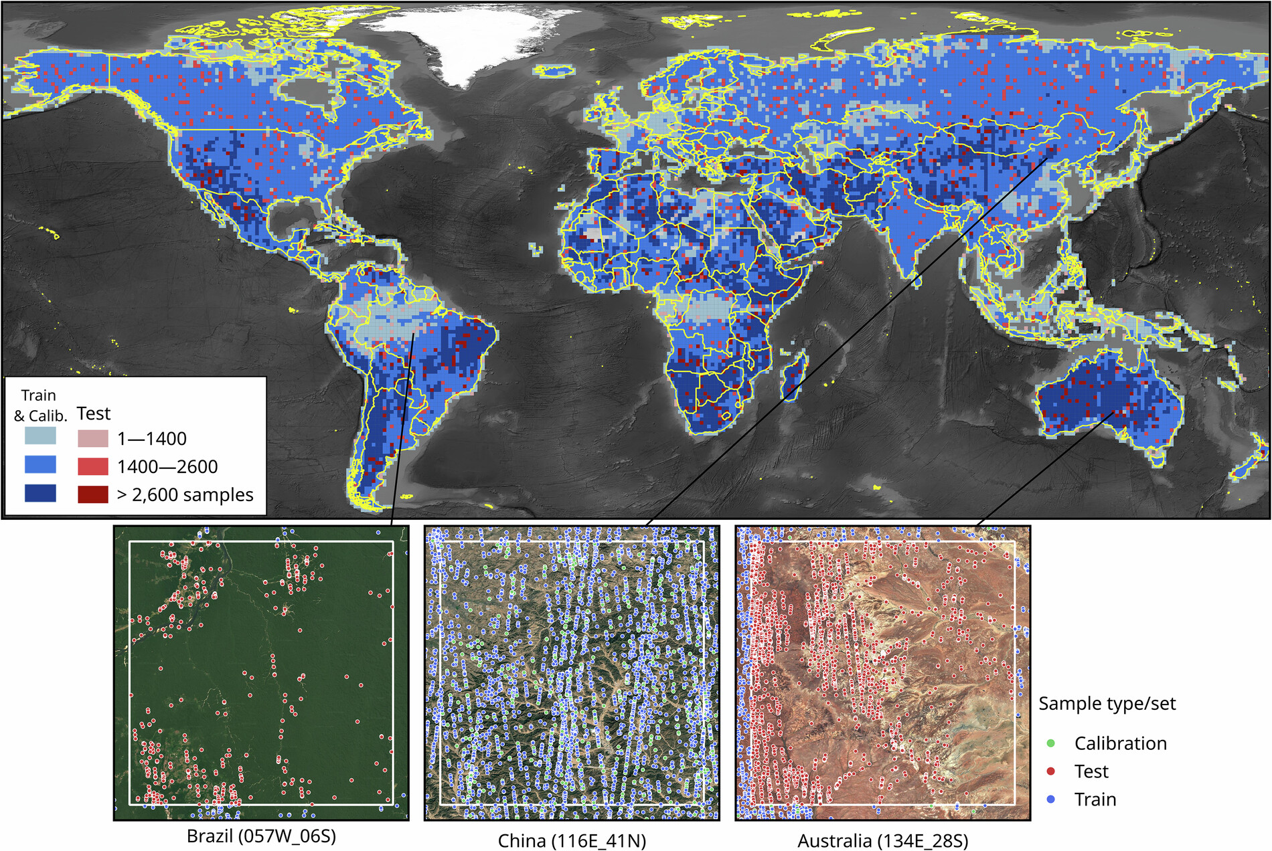
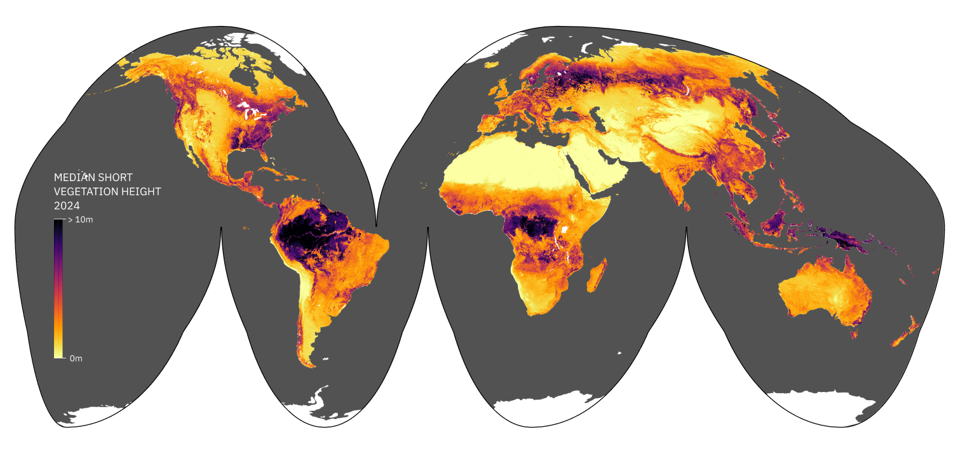

Better vegetation height measurements improve short vegetation ecosystem monitoring
Grassy ecosystems, like savannas, grasslands and tundra, cover ~50% of the Earth’s surface, yet they are commonly excluded from global vegetation height models.
Accurate measurements of vegetation height, including both forests and shorter vegetation, are necessary to understand global carbon storage and biodiversity.
Thirty-two million ICESat-2 20 m segments, along with Landsat composites and other Earth Observation raster data, were used to develop the first global estimate of median vegetation height annually from 2000 – 2024.
The resulting global model generated improved annual height measurements across all ecosystems, enhancing our understanding of short vegetation ecosystems.
Spatial distribution of 32 million ICESat-2 reference samples used for modeling global median vegetation height.
Global map of estimated short vegetation height.
Hunter, M.O., Parente, L., Ho, Yf. et al. Global 30-m annual median vegetation height maps (2000–2022) based on ICESat-2 data and Machine Learning. Sci Data 12, 1470 (2025). https://doi.org/10.1038/s41597-025-05739-6

