Slide 1

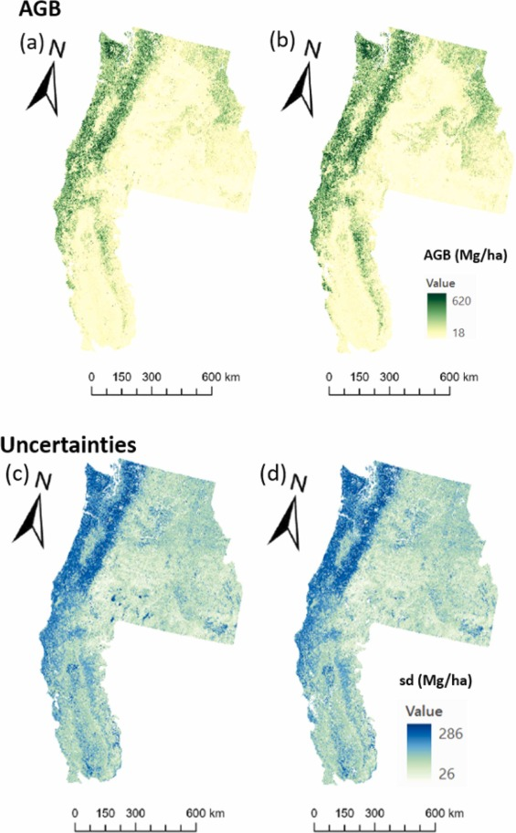

Use of ICESat-2 data to improve forest biomass estimation for resource management
Mapping forest biomass is important for quantifying carbon stocks to provide insights for climate science and to inform natural resource management, such as fuel treatment planning.
Data from ICESat-2, GEDI, and other sources were used to model forest biomass in Oregon, Washington, Idaho, and California in 2016 and 2020.
The model incorporated the Landsat data, GEDI height data, Landscape Fire and Resource Management Planning Tools (LANDFIRE) vegetation data and ICESat-2 derived height data to produce wall-to-wall biomass maps
Results from the study suggest that this modeling approach can provide above ground biomass density to predict the current state of the forests with high accuracy.
AGBD for the study area and the corresponding uncertainties: (a) 2016 AGBD and (b) 2020 AGBD; the standard deviation of errors for (c) 2016 (d) 2020.
Lu, Mei-Kuei, Sorin Popescu, Lonesome Malambo, Andrew Hudak, and Andrew Lister. "Mapping aboveground biomass in Oregon, Washington, Idaho and California with ICESat-2, GEDI and ancillary data." Forest Ecology and Management 595 (2025): 123040.

