Slide 1

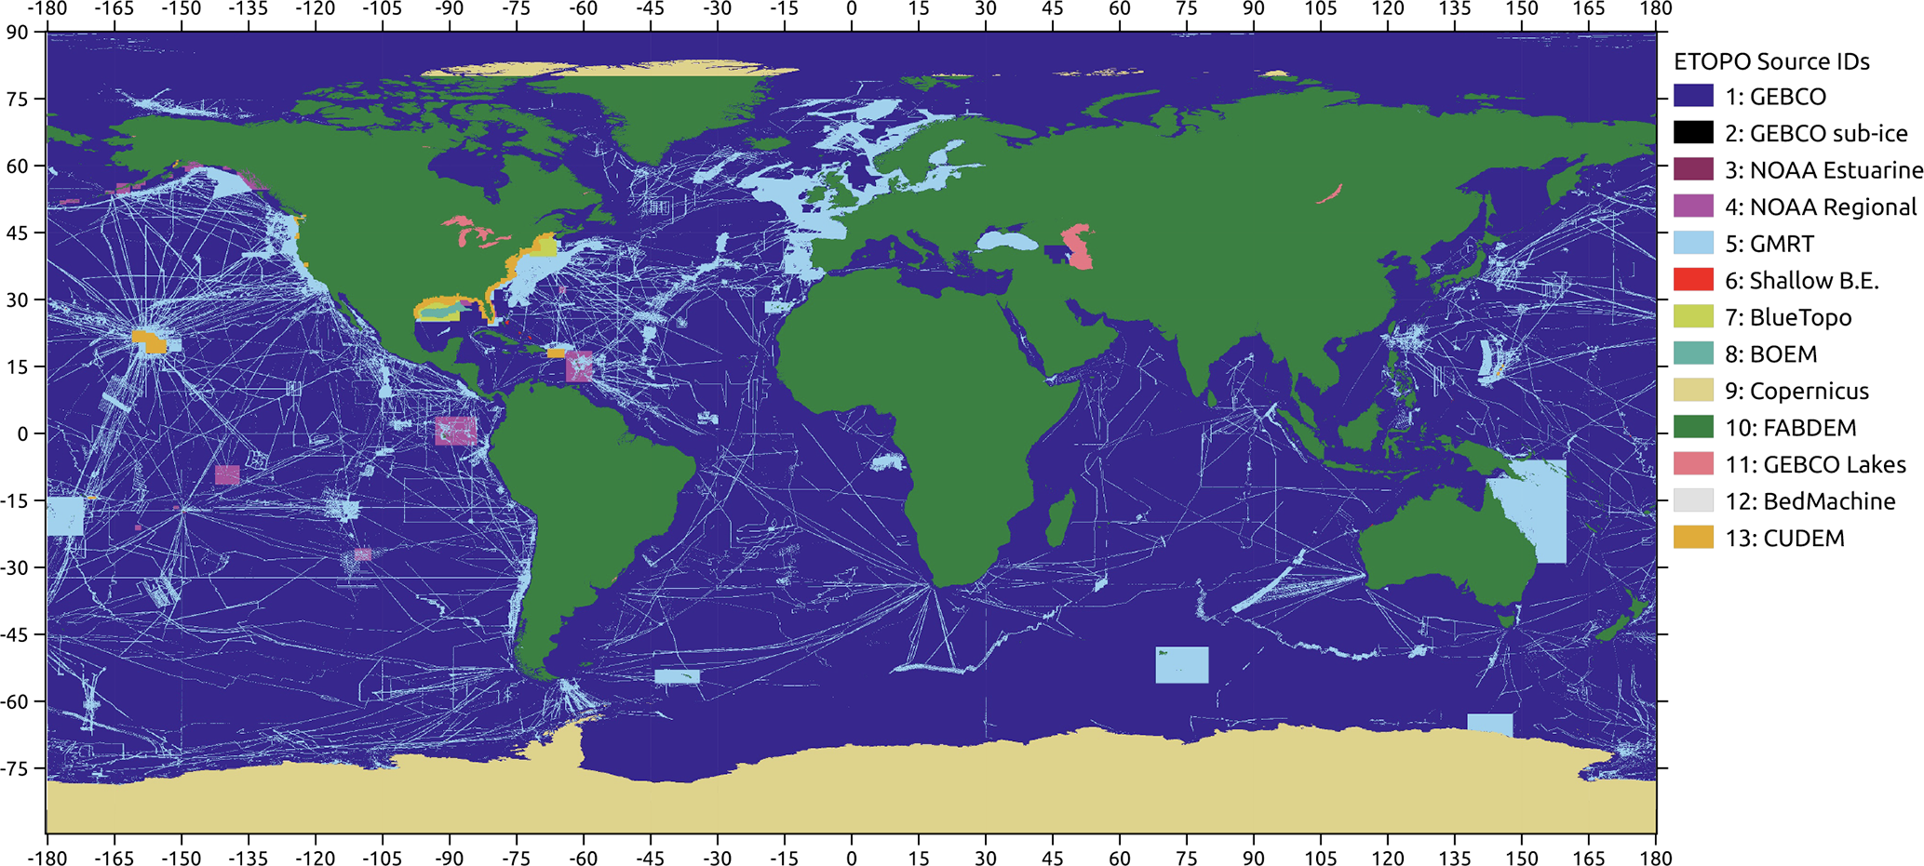
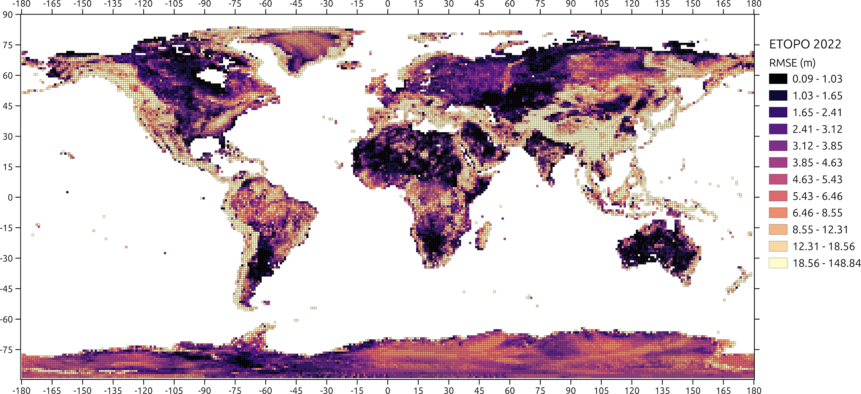

ICESat-2 data evaluate Earth Topography dataset to predict land inundation
Tsunami forecasting, modeling, and warning systems rely upon accurate topographic and bathymetric data to predict and reproduce water movement across global ocean surfaces, wave heights at the coastline, and land inundation.
EarthTOPOgraphy (ETOPO) 2022 is the latest version of NOAA’s global topographic-bathymetric data set.
ETOPO integrates data sets of land topography, sea bathymetry, lake bathymetry, ice-sheet bed elevation.
More than 960 billion lidar measurements from ICESat-2 were used to evaluate vertical accuracy of the land-elevation input datasets.
ETOPO tiles are freely available to use for all private, academic, or commercial purposes except navigation. https://www.ncei.noaa.gov/products/etopo-global-relief-model
Map of ETOPO surface data sets.
MacFerrin, M., Amante, C., Carignan, K., Love, M. and Lim, E., 2025. The earth topography 2022 (ETOPO 2022) global dem dataset. Earth System Science Data, 17(5), pp.1835-1849.
https://doi.org/10.5194/essd-17-1835-2025
Map of ETOPO sub-tiles validated against ICESat-2.

