Slide 1
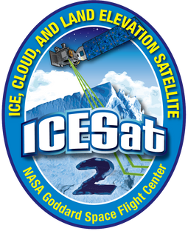

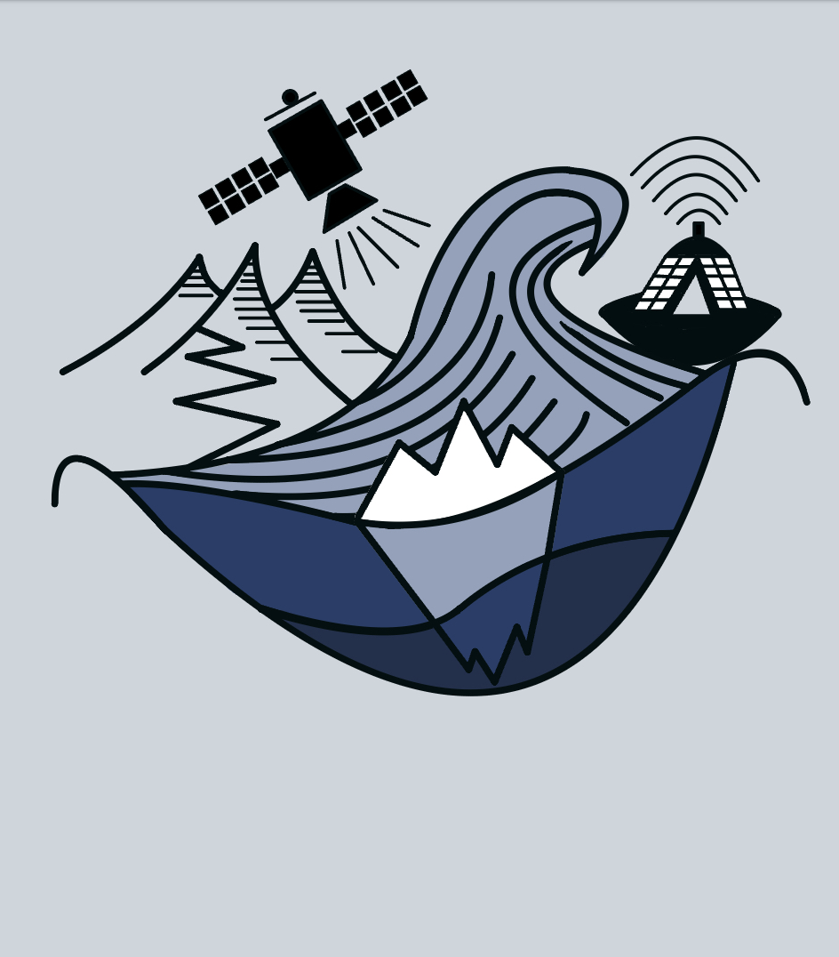

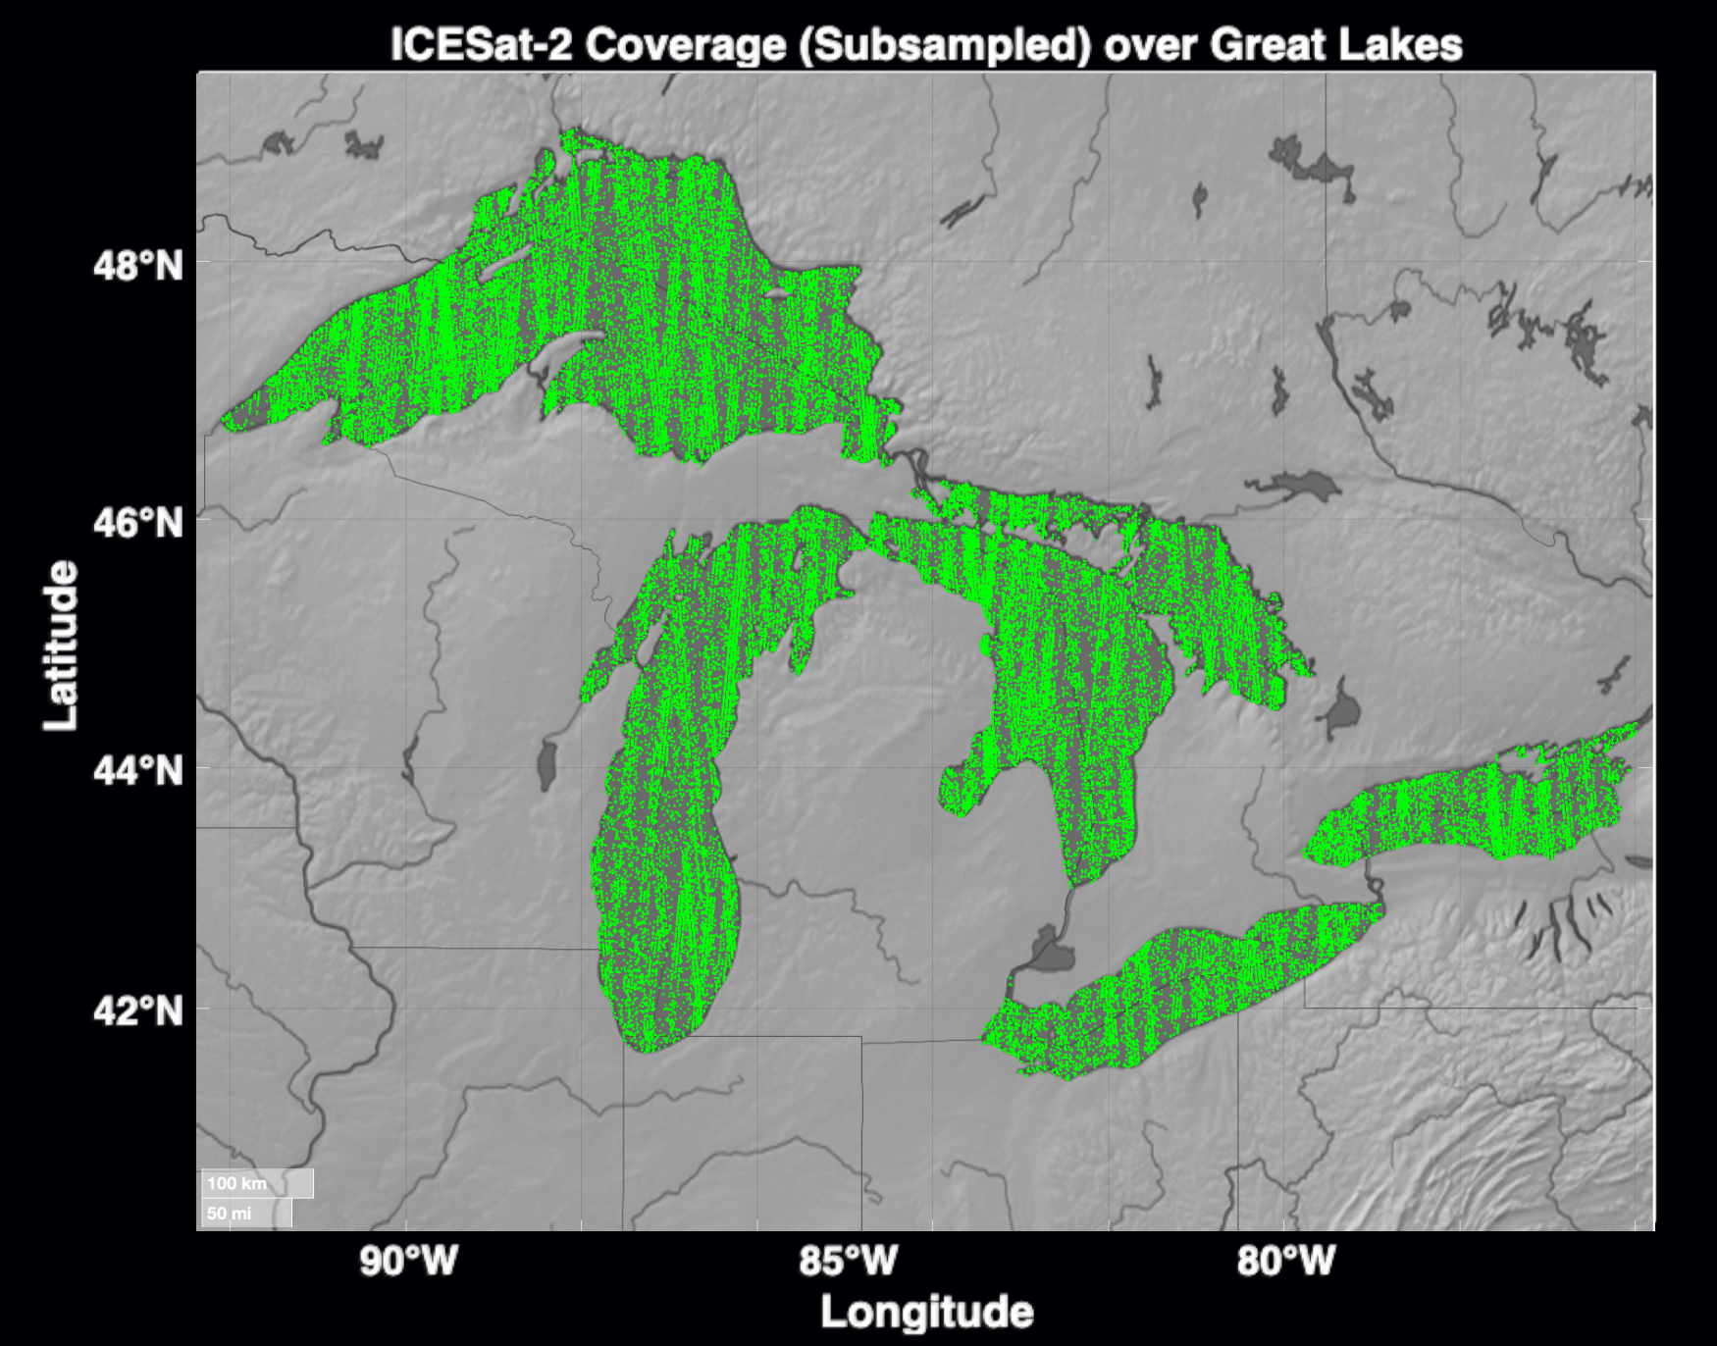
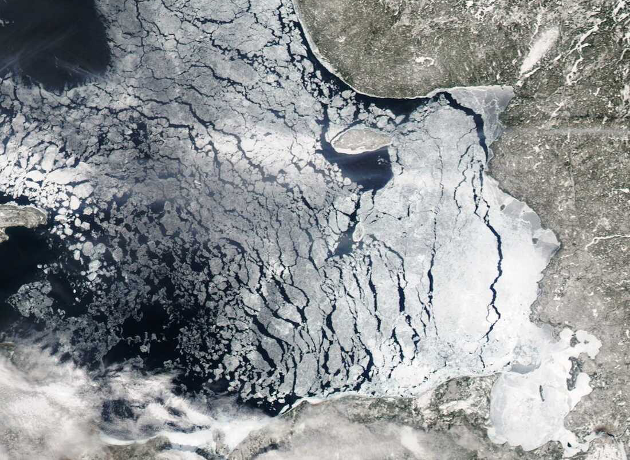
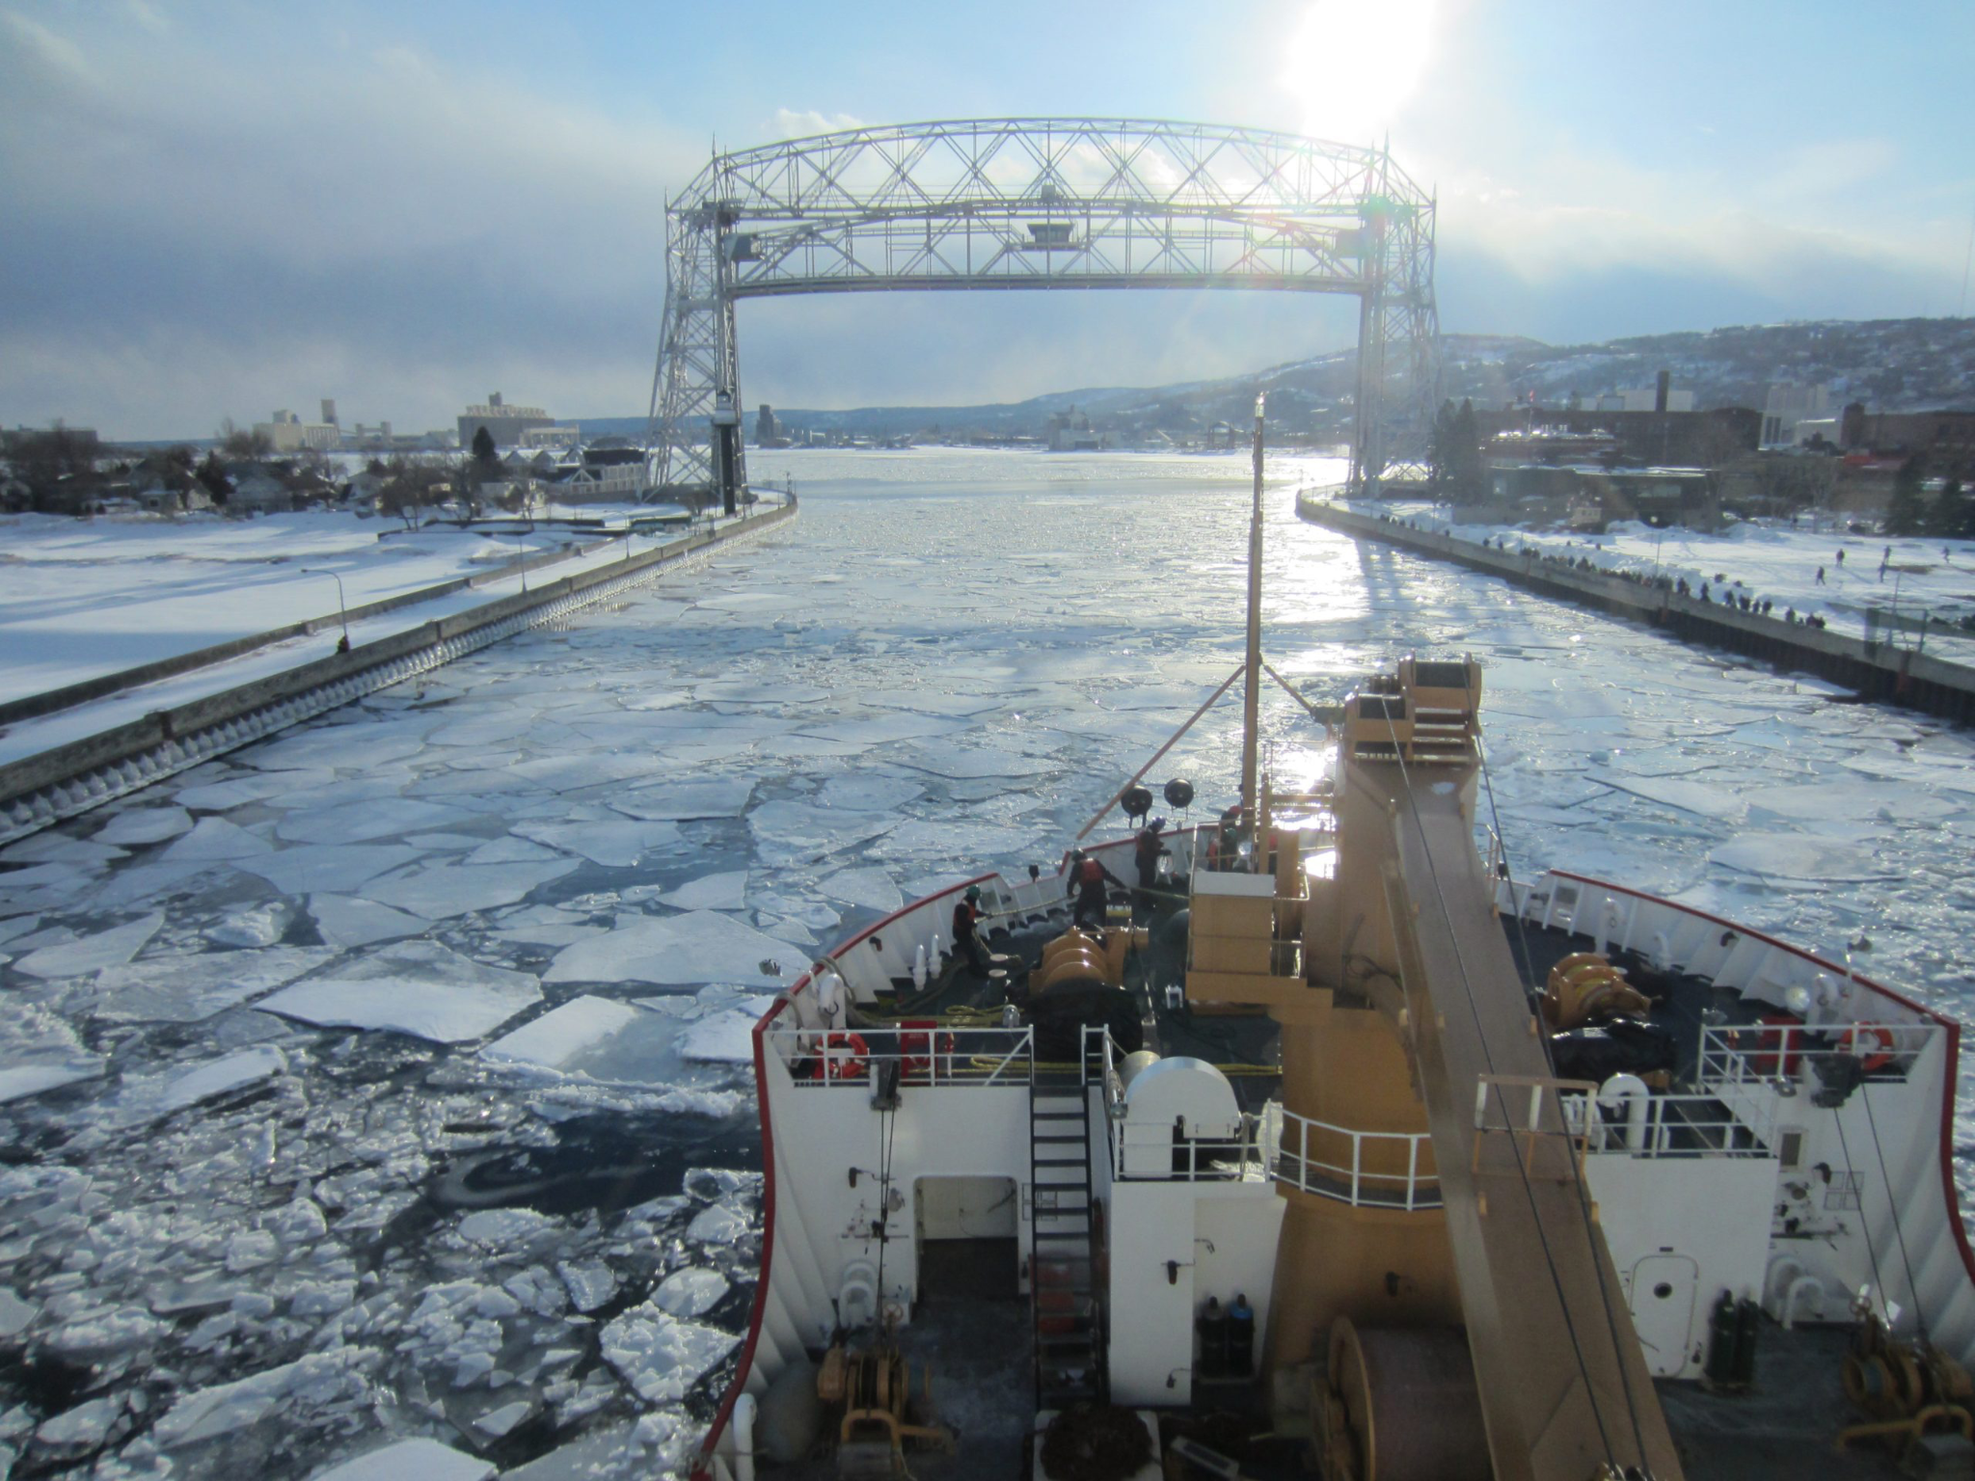
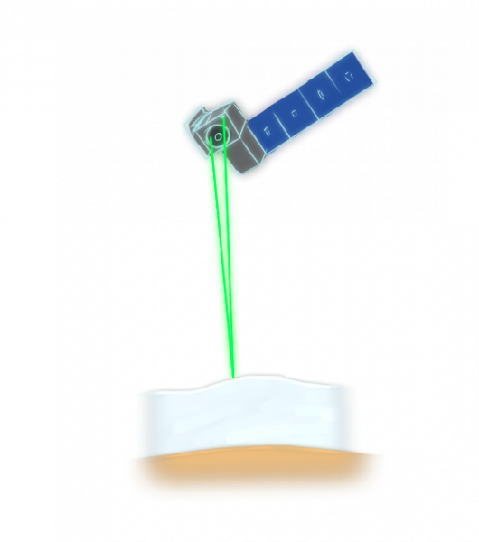
Unparalleled Lake Ice Observations for Commercial Navigation and Forecast Support
SURFACE HYDRODYNAMICS LAB AT MINES
Commercial shipping, Coast Guard operations, and weather forecasting rely on accurate ice information in the Great Lakes.
Navigation and winter tourism activities, represent a multi-billion dollar industry, and support thousands of jobs.
Problem: Accurately distinguishing ice from open water is required for operational measurements of lake ice thickness, which do not yet exist.
Solution: A novel classification algorithm significantly improves the identification of lake ice and open water using ICESat-2.
Impact: Improved forecasting from these observations will ensure safety during recreational activities and navigation.
“open water”
“ice”
“open water”
“ice”
“open water”
Notes:
Figure 1 (top left): Subsampled coverage of ICESat-2 ATL13 data over the North American Great Lakes
Figure 2 (top right): Satellite view of fractional ice on Lake Superior (NOAA Great Lakes Environmental Research Laboratory)
Figure 3 (bottom left): Schematic showing a surface classification algorithm using ICESat-2
Figure 4 (bottom right): Image of a shipping vessel navigating through fractional ice on the North American Great Lakes (NOAA Great Lakes Environmental Research Laboratory)
Large freshwater lakes are critical for human life, ecosystem functioning, and the global carbon cycle. However, consistent high-resolution methods to characterize ice over large lakes remain limited. Here we develop an algorithm to progress ice observations over inland bodies of water by improving surface classifications using data derived from ICESat-2, Landsat 8/9 and other operational products. This algorithm implements a hierarchical approach composed of remote sensing products and data driven machine learning. In this study we show that although the current classification method used in ICESat-2 Inland Surface Water Height (ATL13) is prone to overgeneralization and misclassification, our proposed algorithm, which integrates novel classification methods and data-driven machine learning, enhances surface classification accuracy. We tested this algorithm on a wide breadth of data, spanning four ice seasons in the Laurentian Great Lakes. In our algorithm, we developed two prediction methods that outperformed the current classification method in place for ATL13 by 26.46% and 20.37% and is scalable to other inland surface waters because of the global coverage of the necessary parameters for surface classification. Improved surface classification allows for inland surface bodies of water to be observed with greater detail, particularly using ICESat-2 data, and enables the production of improved data sets of ice concentration and thickness. Improved ice information on Earth’s largest lakes will have cascading effects on not only public safety and operational efficiency, but also the monitoring of anthropogenic changes in these bodies of water.
To view the full publication: https://doi.org/10.1029/2024EA004155

