Slide 1


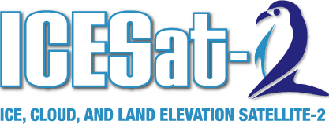
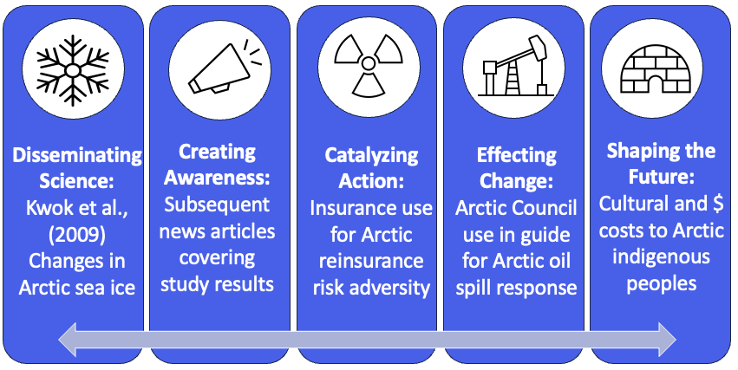
Earth Action Highlight
Assessing the impact of ICESat and ICESat-2 data on decision-making
Limited documentation exists that demonstrates and quantifies the impact of earth science research from NASA missions to societal applications and policy.
The Science Impact Framework uses key indicators to trace and categorize the impact from disseminating science to catalyzing action.
A total of 502 documents were identified that report novel applications of ICESat and ICESat-2 data.
Hazards, such as flooding and fire, were common use cases in which applications developed from ICESat and ICESat-2 data were used in risk assessment.
Notes:
Photo Story
left: Examples of ICESat and ICESat-2 applications in the SIF key indicator categories related to the topic of Arctic sea ice (from Kwok et al. 2009)
right: Relative occurrence of keywords in application documents compared to academic journal articles in Web of Science mentioning ICESat/ICESat-2. “Cryosphere” was most common application keyword in both. Notable differences include digital elevation models (DEMs), bathymetry, vegetation cover, carbon stocks and water resources occurring more frequently in application literature than academic. Ocean science and the atmosphere were common academic topics not not applications.
Paper preprint: https://papers.ssrn.com/sol3/papers.cfm?abstract_id=5191683
Accepted Proof: https://www.sciencedirect.com/science/article/pii/S2352938525002228
Highlight:
Situation/Problem.
There is a large gap remain between academic research and policy [4]
Limited examples linking earth science to applications includes Portier[5] discussing societal applications of NASA’s Global Precipitation Mission (GPM) and Bornmann [6] linking climate change research to policy..
By measuring changes in surface height, the Ice, Cloud, and Land Elevation Satellite (ICESat) (2003-2010) and its successor ICESat-2 (2018-present) have contributed to understanding essential climate variables [1]
Previous work focused on the broad academic impact of these missions [e.g., 2, 3], but previous attempts in documenting the policy and societal benefit of the mission have missed many known applications and their impact.
Solution:
We used the Scientific Impact Framework (SIF) which was developed to demonstrate impacts of CDC science [7].
Definitions for each key indicator along with kinds of documents that may show that category are outlined in the “Measuring Impact” table. To discover documents and applications, we identified numerous relevant data sources and databases including Overton, GovInfo, Web of Science, Google Scholar, Web of Science, regulations.gov, data.gov, United States Patent and Trademark Office, the Internet Archive, and ICESat-2 User metrics.
This study documents a large number of impactful applications relevant to catalyzing action, effecting change and shaping the future into the literature.
Example given from the 2009 Kwok paper [8] that shows how science ultimate affected policy in the arctic.
Impact/Result.
In total, we identified 502 documents that report novel applications of ICESat and ICESat-2 data.
From these 502 documents, 46 were classified into “Disseminating Science,” 99 in “Creating Awareness,” 178 into “Catalyzing Action,” and 59 into “Shaping the Future”.
Hazards such as flood or fire was a common category for “Effecting Change” and “Shaping the Future,” reflecting how risk determination often resulted from ICESat applications, rather than initial mission data and science research findings.
Climate change was the most common topic for “Effecting Change,” reflecting how mission data and products are resulting in changes in response to climate change
The broad range of topics reflects the diverse impacts of both ICESat missions.
[1] Magruder, Lori A., Sinead L. Farrell, Amy Neuenschwander, Laura Duncanson, Beata Csatho, Sahra Kacimi, and Helen A. Fricker. 2024. “Monitoring Earth’s Climate Variables with Satellite Laser Altimetry” 5 (2): 120–36.
[2] Chen, Yifu, Yuan Le, Dongfang Zhang, Yong Wang, Zhenge Qiu, and Lizhe Wang. 2021. “A Photon-Counting LiDAR Bathymetric Method Based on Adaptive Variable Ellipse Filtering.” Remote Sensing of the Environment 256 (112326): 112326.
[3] Magruder, Lori, Thomas Neumann, and Nathan Kurtz. 2021. “ICESat-2 Early Mission Synopsis and Observatory Performance.” Earth and Space Science (Hoboken, N.J.) 8 (5): e2020EA001555.
[4] Ahmed, Mahfooz, Roslina Bt. Othman, and Mohamad Fauzan Noordin. 2023. “Trends in Open Science: A Bibliometric Analysis of Research Topics, Citations, Journals, and Productive Entities.” Journal of Information Systems and Digital Technologies 5 (2): 170–93.
[5] Portier, Andrea, Dalia Kirschbaum, Mekonnen Gebremichael, Eric Kemp, Sujay Kumar, Iker Llabres, Eric Snodgrass, and Jerry Wegiel. 2023. “NASA’s Global Precipitation Measurement Mission: Leveraging Stakeholder Engagement & Applications Activities to Inform Decision-Making.” Remote Sensing Applications Society and Environment 29 (100853): 100853.
[6] Bornmann, Lutz, Robin Haunschild, Kevin Boyack, Werner Marx, and Jan C. Minx. 2022. “How Relevant Is Climate Change Research for Climate Change Policy? An Empirical Analysis Based on Overton Data.” PloS One 17 (9): e0274693.
[7] Ari, Mary D., John Iskander, John Araujo, Christine Casey, John Kools, Bin Chen, Robert Swain, Miriam Kelly, and Tanja Popovic. 2020. “A Science Impact Framework to Measure Impact beyond Journal Metrics.” PloS One 15 (12): e0244407
[8] Kwok, R. 2018. “Arctic Sea Ice Thickness, Volume, and Multiyear Ice Coverage: Losses and Coupled Variability (1958–2018).” Environmental Research Letters 13 (October). https://doi.org/10.1088/1748-9326/aae3ec.
Learn more about ATL24 during the Earthdata webinar here - https://www.youtube.com/watch?v=yX0N0ij1iQ4
More information about the data product - https://nsidc.org/data/atl24/versions/1
More info:
Early Adopters - Before launch, ICESat-2’s Early Adopters program built a broad user community to maximize data use and explore potential applications.
Applied Users - After launch, Early Adopters became the Applied Users program, which promotes applications research on integrating ICESat-2 data into organizations’ policy, business, and management activities to improve decision-making efforts.
Satellite-derived bathymetry (SDB) is the process of mapping the seafloor using satellite imagery, relating light penetration and reflection in water to estimate depths.
SDB provides several advantages, including cost-effectiveness, global coverage and faster data acquisition. SDB can be limited by water clarity, preventing light from reaching the bottom, spatial resolution of the remote sensing measurement and accuracy, depending on the method and satellite platform/instrument.
Despite its limitations, SDB can be used in a wide variety of applications, including coastal zone management, navigation and safety, marine habitat monitoring and disaster response.
ICESat-2 has become a major contributor to SDB, with over 2000 publications on this topic to date. Now is the time to think about the state-of-the-art and additional capabilities of SDB for the future.

