Slide 1

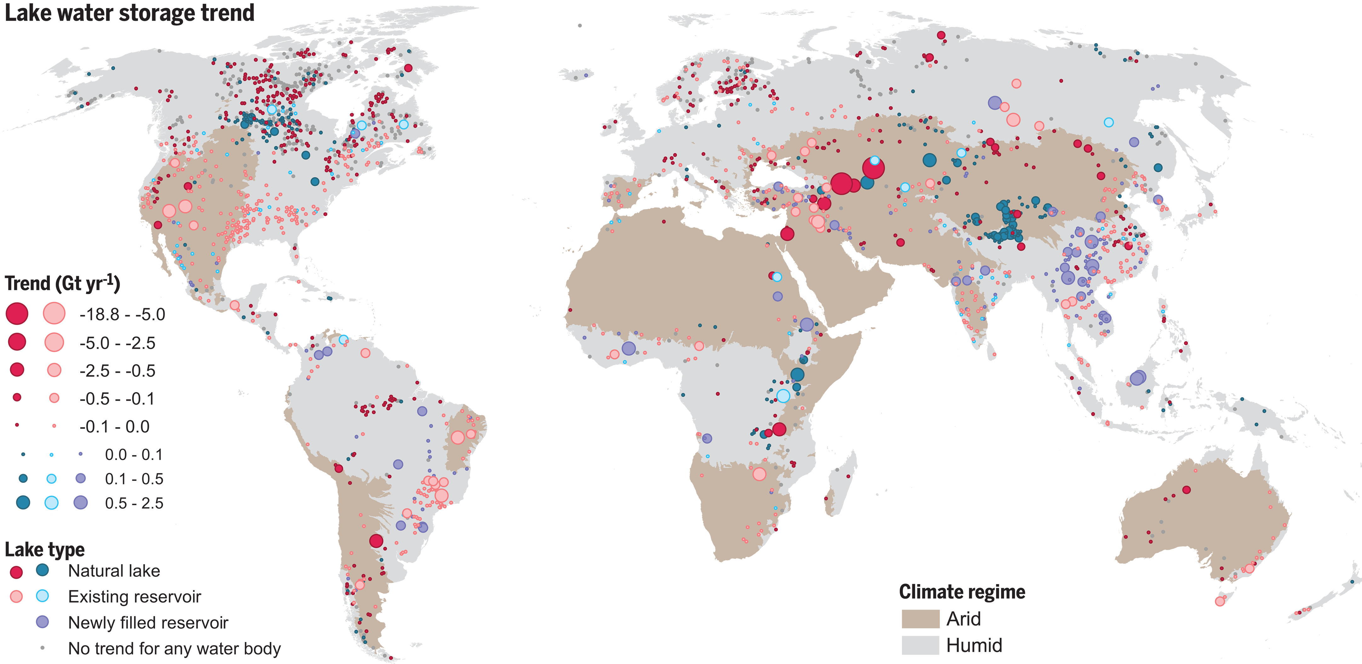
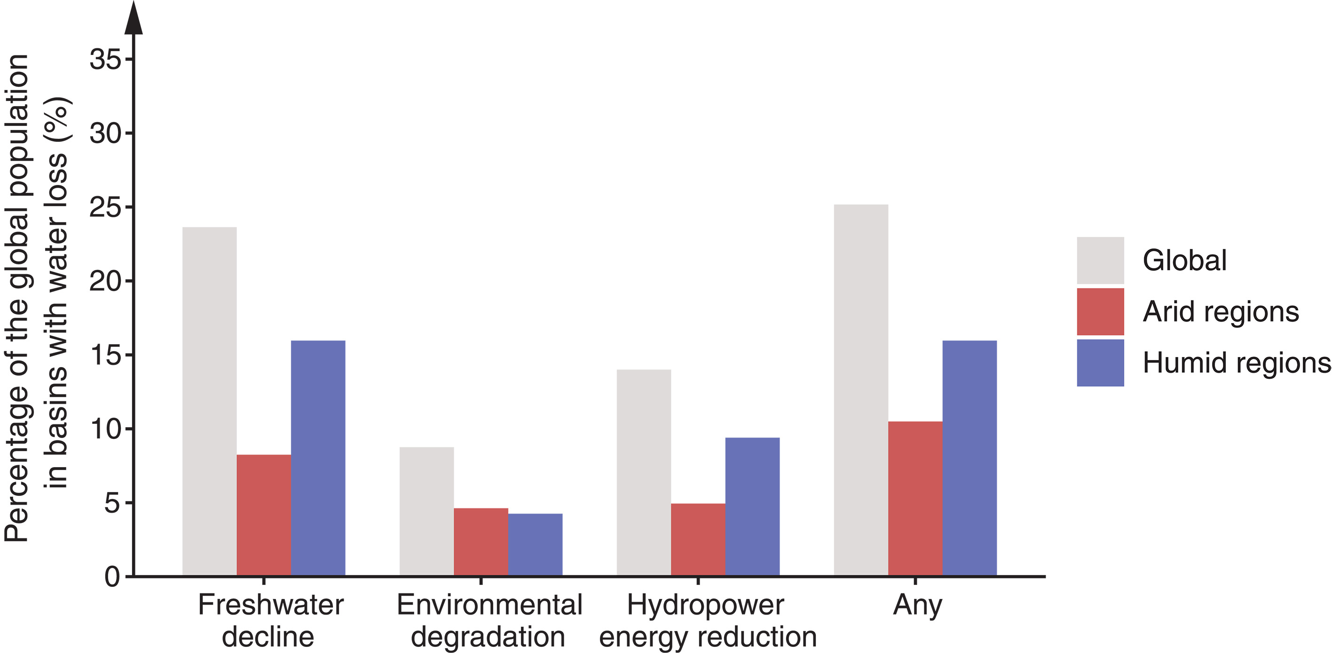

Widespread drop in lake and reservoir storage seen by ICESat-2 and other satellites
From 1992 to 2022, more than 50% of large natural lakes and reservoirs experienced volume loss due to both human and climatic drivers.
These results are from an analysis of 1,972 of the world's largest lakes using satellite observations including ICESat-2, climate data, and hydrologic models.
Findings emphasize the need to improve water management to protect essential ecosystem services such as drinking water and irrigation supply, habitat, cycling of pollutants and nutrients, and recreation.
Widespread storage decline in large global lakes from October 1992 to September 2020.
Yao, F., Livneh, B., Rajagopalan, B., Wang, J., Crétaux, J.-F., Wada, Y., & Berge-Nguyen, M. (2023). Satellites Reveal Widespread Decline in Global Lake Water Storage. Science 380, 743–749. https://doi.org/10.1126/science.abo2812.
Percentages of the global population residing in basins experiencing significant lake water loss.

