Slide 1

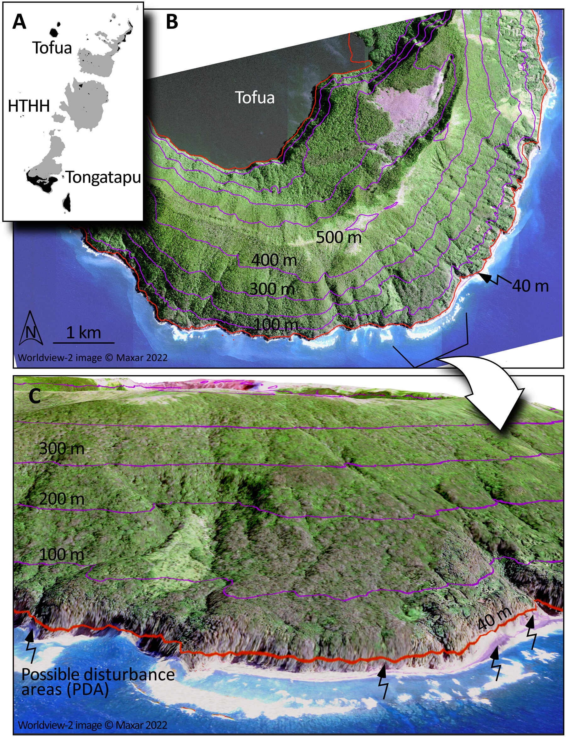

Megatsunami simulation using ICESat-2 and other data can inform future hazards
The January 2022 volcanic eruption of Hunga Tonga-Hunga Ha’apai (HTHH), one of the largest natural explosions in more than a century, generated a catastrophic tsunami in the South Pacific Ocean.
Researchers generated a tsunami simulation of the Tongan Archipelago – calibrated by field observations, drone and satellite data including ICESat-2 – which provided an understanding of the tsunami and a framework for assessment of future hazards.
Several lives were lost, but based on the simulation, the researchers found HTHH’s location relative to population centers saved Tonga from a worse outcome.
Other oceanic volcanoes are capable of creating future tsunamis at HTHH’s scale.
Purkis, S. J., Ward, S. N., Fitzpatrick, N. M., Garvin, J. B., Slayback, D., Cronin, S. J., .Palaseanu-LoveJoy, M., & Dempsey, A. (2023). The 2022 Hunga-Tonga megatsunami: Near-field simulation of a once-in-a-century event. Science Advances, 9(15), eadf5493. https://doi.org/10.1126/sciadv.adf5493.
Post-tsunami disturbances along the southern flank of Tofua Island based on synthetic aperture radar, DEM, and optical imaging analysis.

