Slide 1

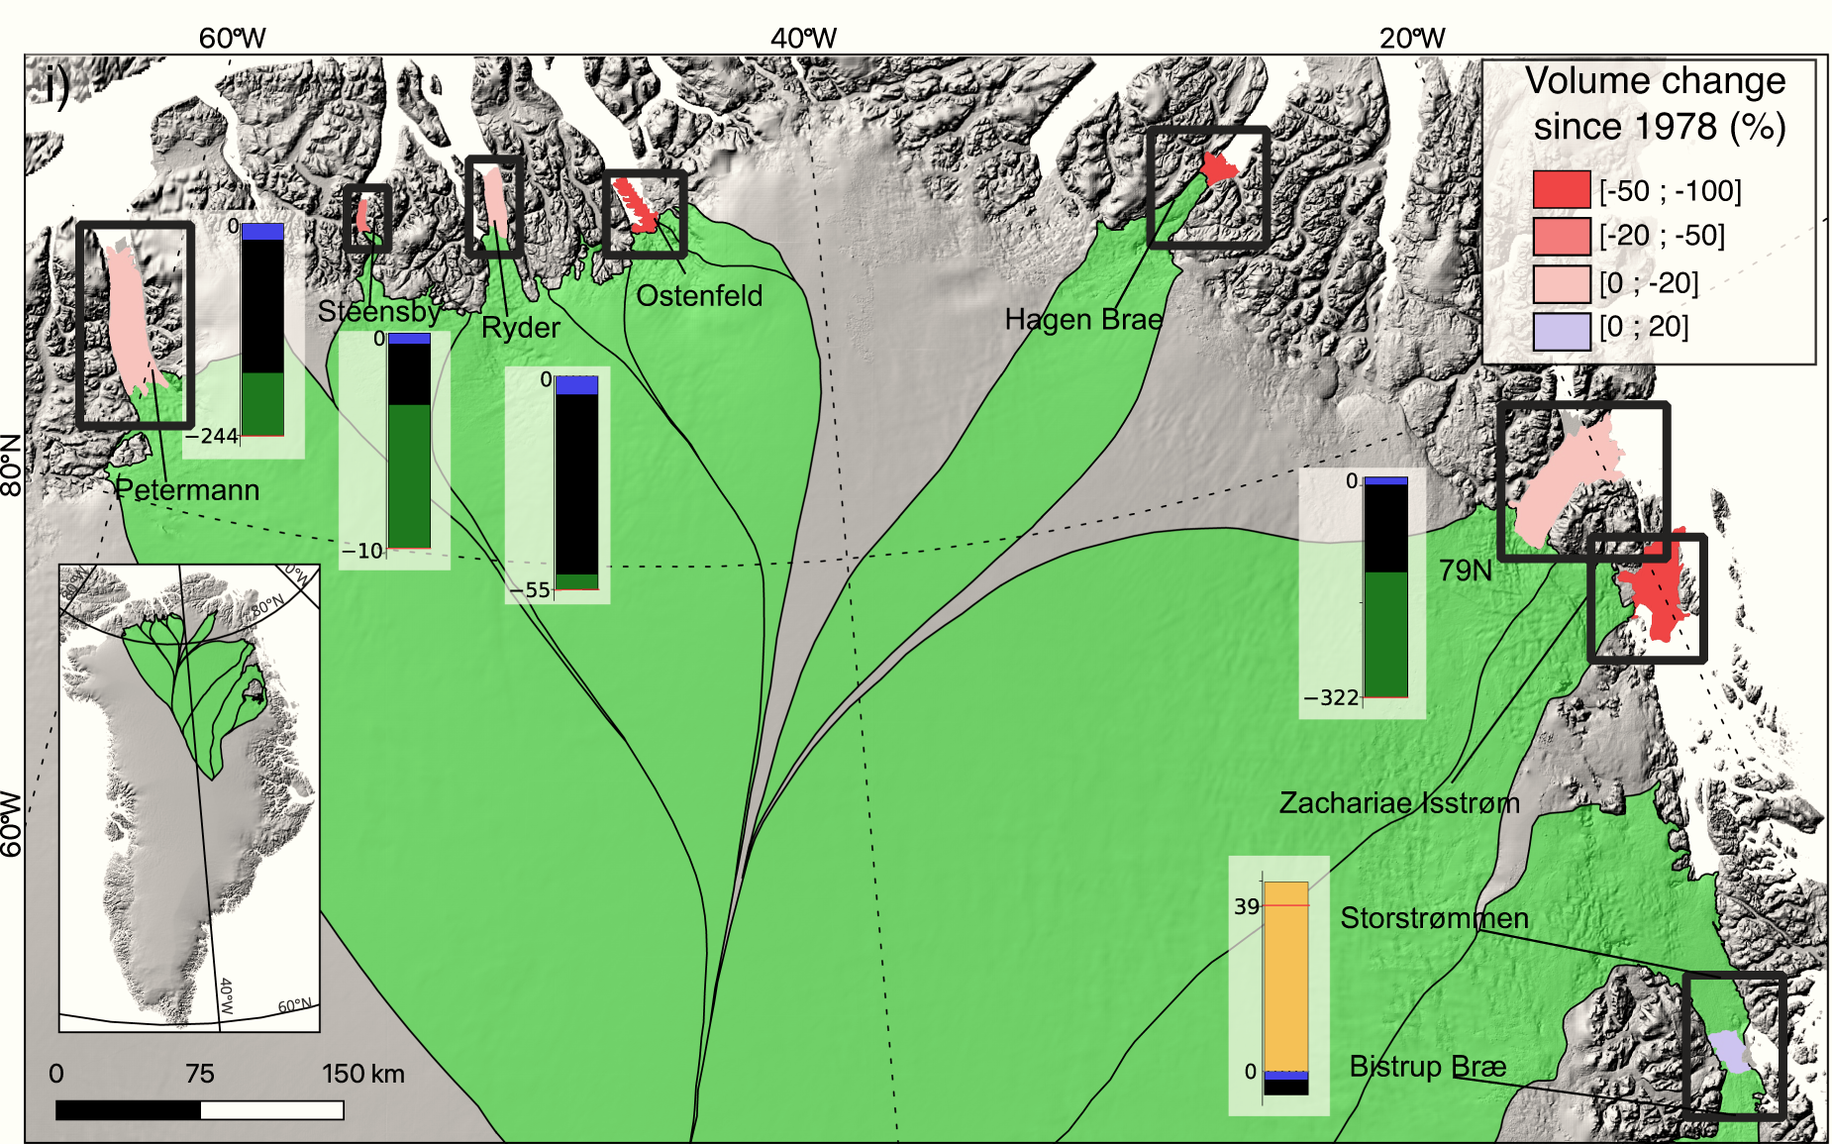

ICESat-2 reveals rapid disintegration and weakening of ice shelves in North Greenland threatening drastic sea level rise
Surface elevation data reveal yearly changes in ice shelf thickness and basal melt since 2000, with ICESat-2 data from 2018 onward.
North Greenland ice shelves have lost more than 35% of their total volume – three have collapsed entirely; the rest are melting and destabilizing nearby glaciers.
Basal melt rates will remain high threatening the long-term stability of Greenland’s glaciers.
Millan, R., Jager, E., Mouginot, J., Wood, M.H., Larsen, SH., Mathiot, P., Jourdain, N.C., & Bjørk, A. (2023). Rapid disintegration and weakening of ice shelves in North Greenland. Nature Communications 14, 6914. https://doi.org/10.1038/s41467-023-42198-2.

