Slide 1

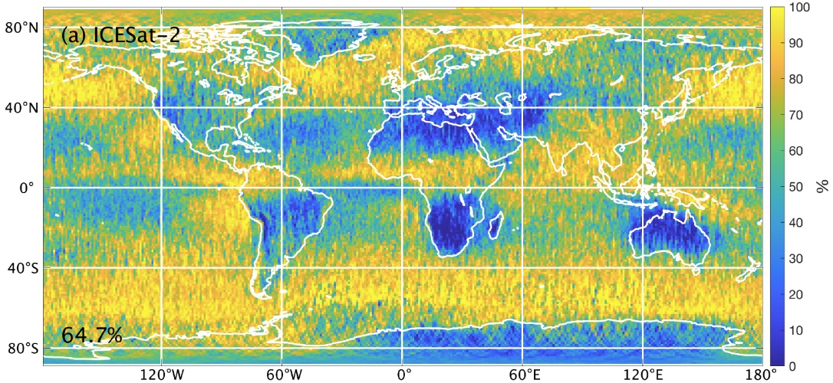
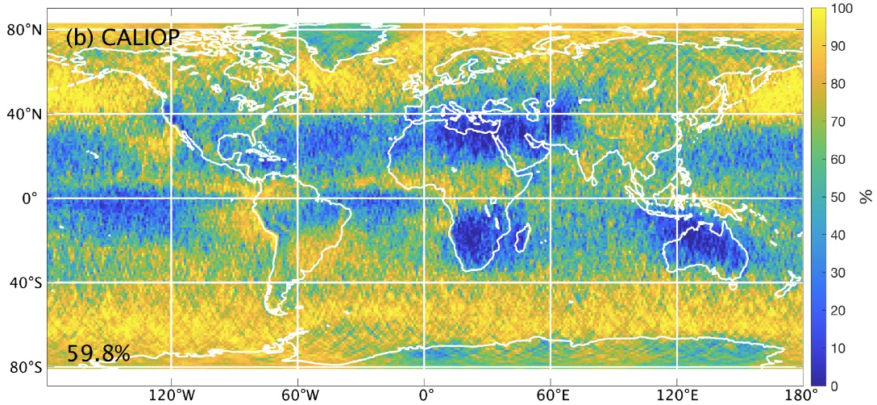
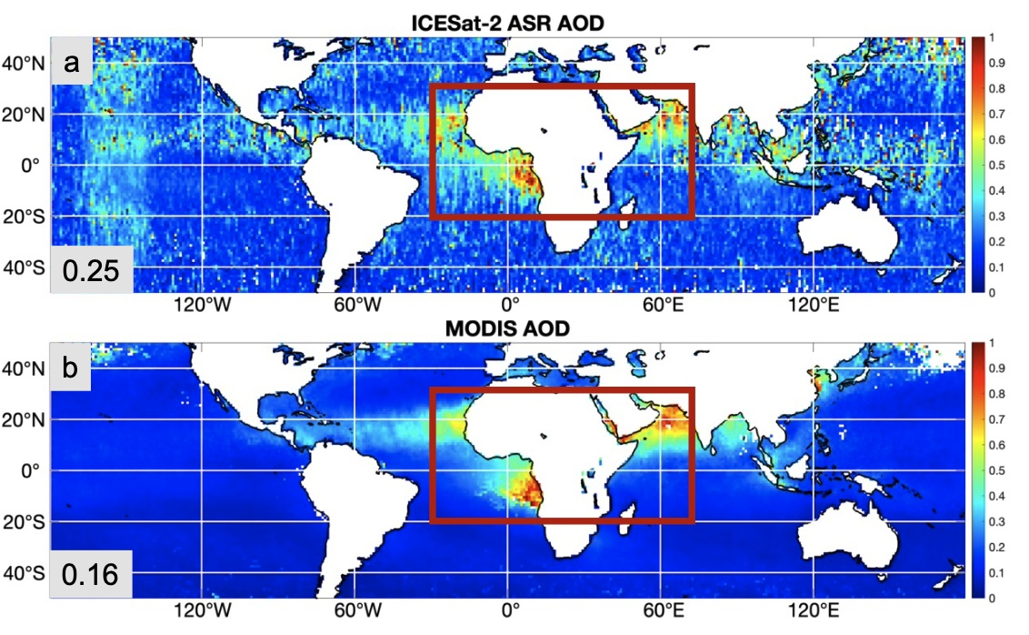

ICESat-2 continues monitoring clouds and aerosols post-CALIOP
Clouds and aerosols directly impact weather prediction, air quality, and long-term planning
From 2006 to 2023, NASA’s CALIPSO mission provided reliable, global atmospheric profiling with its CALIOP lidar
ICESat-2 now continues that legacy with advanced, high-resolution cloud and aerosol measurements
NASA confirms strong alignment between ICESat-2, CALIOP, and MODIS, ensuring data consistency
ICESat-2 delivers critical atmospheric insight while we prepare for the next generation of U.S. lidar technology
Summer 2019 Cloud Detection Frequency
(a) ICESat-2 and (b) CALIOP show strong agreement in global cloud coverage during June–August (JJA), demonstrating ICESat-2’s capability to continue critical atmospheric monitoring.
Christian, K. E., Palm, S. P., Yorks, J. E., & Nowottnick, E. P. (2025). Evaluation of ICESat-2 ATL09 Atmospheric Products Using CALIOP and MODIS Space-Based Observations. Remote Sensing, 17(3), 482. https://doi.org/10.3390/rs17030482.
Average aerosol optical depth for JJA 2019 as observed by (a) ICESat-2 and (b) MODIS. Red boxes outline the region of higher aerosol optical depth and better agreement.

