Slide 1

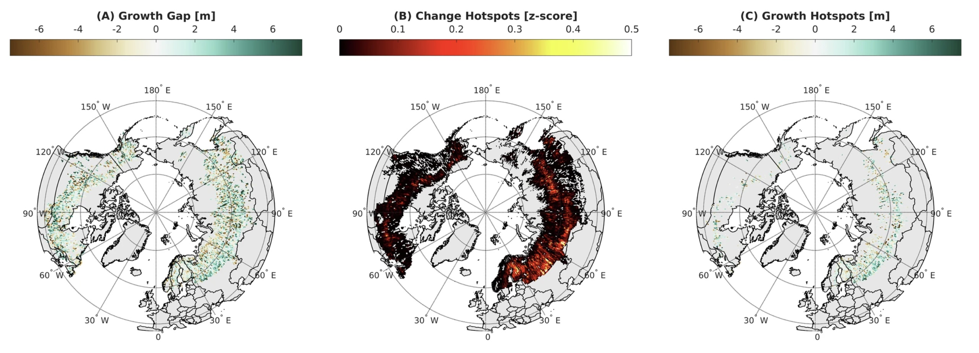

ICESat-2 data reveals a carbon sink potential in Boreal Forests
Boreal forests are approximately a third of the Earth's forested area, and they are warming quickly.
Russia accounts for 73% of global boreal forest change and could act as a carbon sink.
ICESat-2 heights were collated with Landsat estimates of disturbance and age to estimate growth potential.
Growth gaps and hotspots of forest growth were identified in southwest Russia.
Boreal forest growth and change hotspots
Neigh, C.S.R., Montesano, P., Sexton, J.O., Wooten, M., Wagner, W., Feng, M., Carvalhais, N., Calle, L., & Carroll, M.L. (2025). Russian Forests Show Strong Potential for Young Forest Growth. Communications Earth & Environment 6, 71. https://doi.org/10.1038/s43247-025-02006-9.

