Slide 1



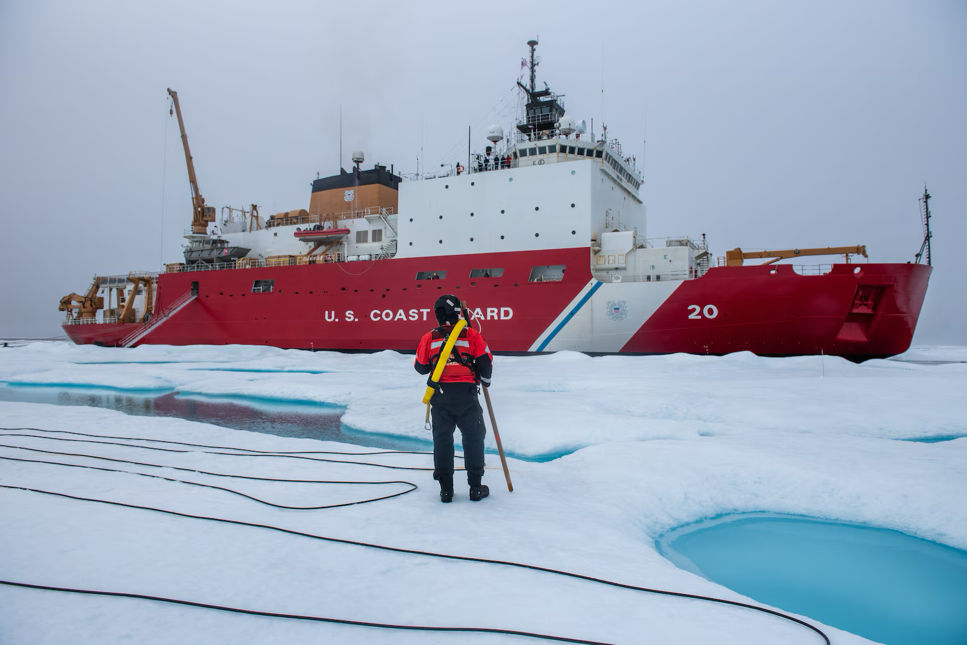
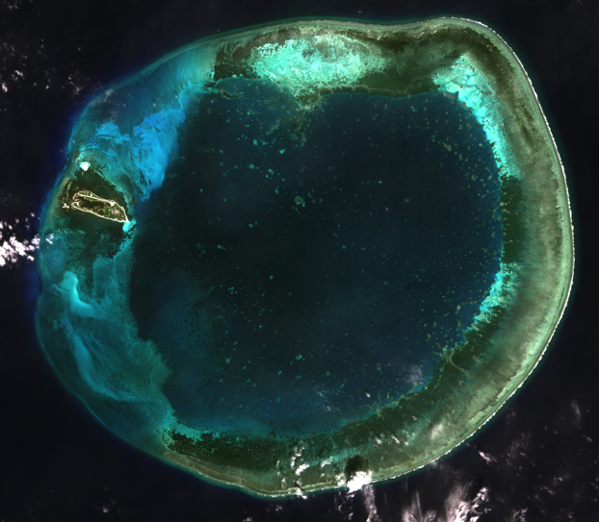
Navigating hazardous waters in the Arctic and South China Sea
The U.S. Naval Research Laboratory (NRL)¹ has an operational responsibility to provide regular updates of sea ice conditions to vessels for safe navigation through the Arctic.
The NRL requires accurate data on sea ice thickness from ICESat-2 and other Earth Observing systems to improve sea ice forecasts from models.
Bathymetry, the mapping of the ocean floor, is important for ships navigating shallow waters to avoid hazards, such as coral reefs and other bottom features and well as the conservation of marine ecosystems.
Taiwan’s Ministry of the Interior manages 280 islands situated in the South China Sea that are formed by groups of atolls, coral reefs and sea banks
The use of ICESat-2 together with Sentinel-2 data to produce satellite derived bathymetry to develop early warning of changes in shallow waters and as a source for electronic navigational charts as well as the detection of illegal dredging². Successful mapping has already been done for >130 islands in the South China Sea and more is underway.
Top: Coast Guard Cutter Healy, Bottom: Coral reef in South China Sea
Notes:
1) https://icesat-2.gsfc.nasa.gov/applied-users/richard-allard
2) https://icesat-2.gsfc.nasa.gov/applied-users/kuo-hsin-tseng
Quotes from Dr. Neil Weston, NOAA (retired) May 3, 2021
"[ICESat-2] it's really a great sensor in the fact that we just have to wait for it to pass over a particular region of interest. It saves us from sending a ship to Alaska, if you will, to do the survey that may cost hundreds of thousands of dollars, and maybe three months of work. You got to sail the ship there--that's $20,000 a day, do field work along the shore. But, if we look at ICESat-2, we can just find out what date and time the satellite passed overhead on these particular regions, and I think NASA has provided excellent tools for clipping the data."
"I can find out within 20 minutes what day the ICESat-2 has passed over Key West and then I could look at specific shoreline features that I want to determine if there is any change. I don't need to send NOAA resources down there to determine that, I can use the ICESat-2 satellite."
"I can't even put an estimate on how much savings that's allowing us to do, but it's really remarkable."
"When we have measurements on an older nautical chart, let's say it was made in 1960s, it'd use led line processing. So, you'd have a ship throw a lead line over, and that measurement would only be good for that location, but with the ICESat, it sweeps over the surface of the earth so you can basically develop a grid data points and that's what we do."
"ICESat-2 allows us to provide a second check, basically anywhere on the surface of the earth. If there are colleagues in Australia that were doing hydrographic surveys you could certainly use the sensor to get a second estimate of, are we in the right ballpark? And so that in and of itself is very valuable to us." "Most of the commerce for the United States comes in through shipping, 90%, and those ships are required to use the nautical charts. So they're updated maybe every 30 days and sometimes faster if there's been changed detected in a specific area. So, the data is definitely valuable to us in many different ways." ---------------------------
More on Steven Tseng, ICESat-2 Early Adopter
PI Steven Tseng has been actively engaging with the Ministry of Interior in Taiwan for this application and also promoting the SDB technique used to other institutions (e.g., Macau University of Science and Technology). As such, he is acting as both an Early Adopter and ambassador to the mission. Tseng's work demonstrates the utility of satellite data, particularly ICESat-2 data, for monitoring changes in shallow waters. It is estimated that 70-90% of Taiwan's islands in the South China Sea have been damaged by illegal sea sand dredging and other activities. Tseng has successfully mapped dozens of islands in the South China Sea to establish reliability for operational use by Taiwan's Ministry of Interior (ARL 8).
More than 280 islands situated in the South China Sea are formed by groups of atolls, coral reefs, and sea banks that are intricately interwoven with precious marine life. Some of them are managed by Taiwan’s Ministry of the Interior and protected by the Ocean Affairs Council to prevent the loss of sediment and the degradation of benthic habitat from anthropogenic forcing, as well as to restore and conserve marine biology. The Center for Space and Remote Sensing Research (CSRSR) at National Central University works with Taiwan’s Dept. of Land Administration, Ministry of the Interior to map both the land and nearshore areas of Taiwan. Our work provides information to help monitor the transportation of sediment and the change of benthic types. The use of ICESat-2 together with Sentinel-2 data to produce satellite derived bathymetry (SDB) has helped demonstrate the capability to use satellite data to attempt early warning of changes in shallow waters. We have produced SDB in many other islands in the South China Sea as a source for electronic navigational charts (ENCs). ENCs are used to identify ship navigation, particularly when going nearshore, as well as sea sand dredging, sunken ships, and status or change of underwater terrain. Successful mapping has already been done for >130 islands in the South China Sea and more mapping is underway.

