Slide 1

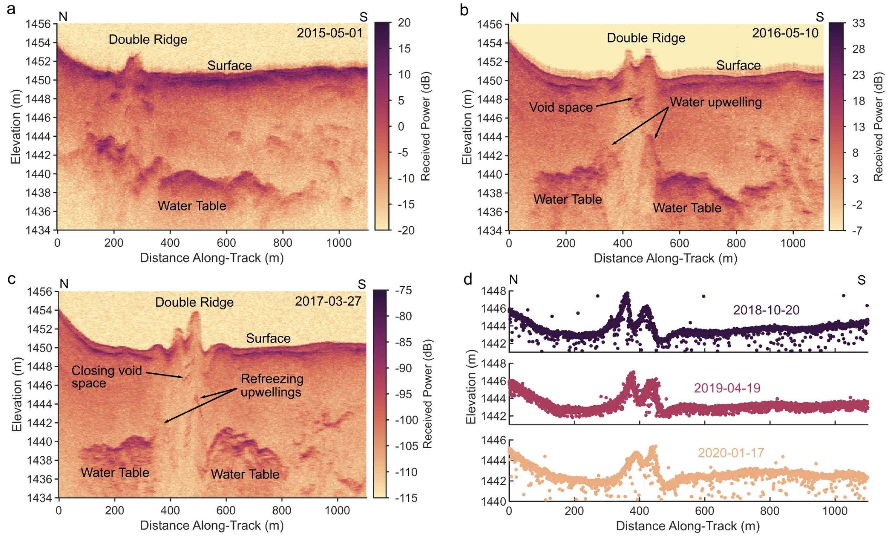

Clues to Europa ice ridges from ICESat-2 and radar data
To investigate how double ridge features form on the ice shell of Jupiter’s moon Europa, scientists studied similar structures in Northwest Greenland with ICESat-2 and radar sounding data.
They found that the refreezing of shallow liquid water pockets within Europa’s ice shell could form double ridges.
Studying the mechanisms by which features like double ridges evolve provides a better understanding of the structure, dynamics, and habitability of Europa’s ice shell.
Time series of high-resolution radargrams and ICESat-2 laser altimetry showing the evolution of the double ridge system.
Culberg, R., Schroeder, D.M. & Steinbrügge, G. Double ridge formation over shallow water sills on Jupiter’s moon Europa (2022). Nature Communications 13, 2007. https://doi.org/10.1038/s41467-022-29458-3

