Slide 1




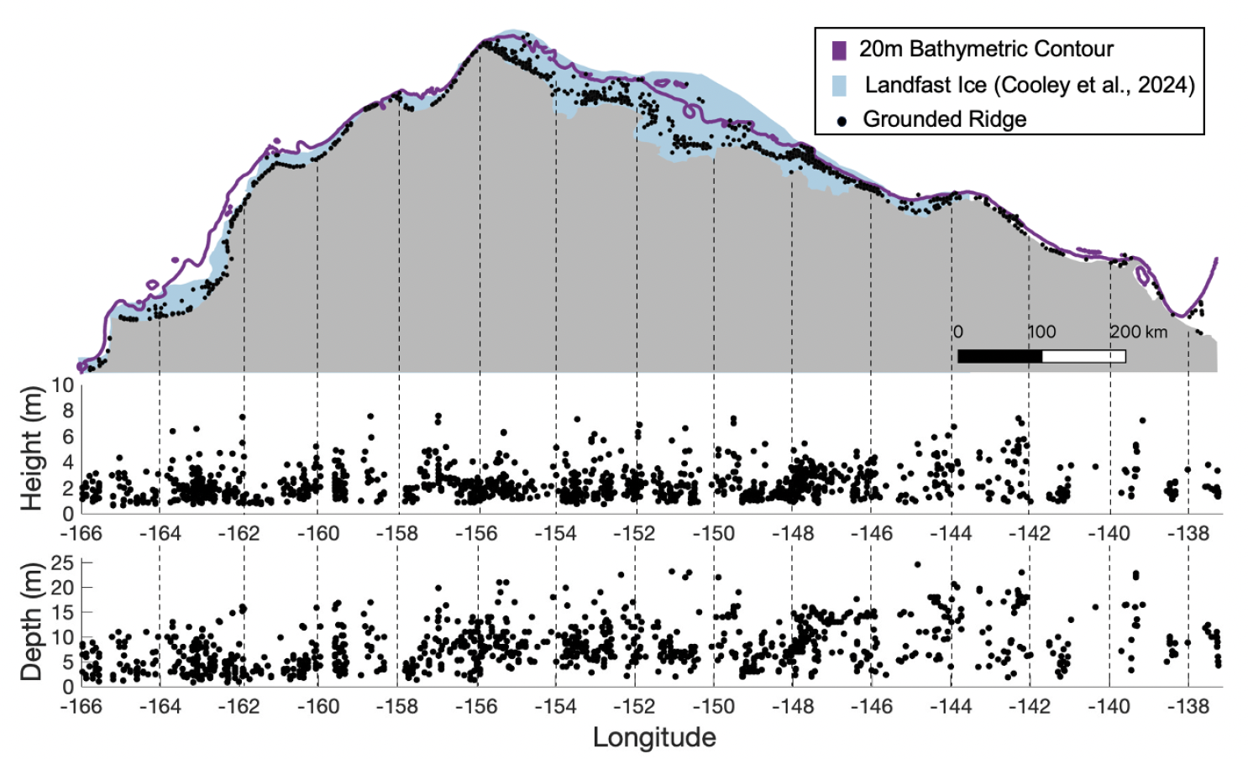
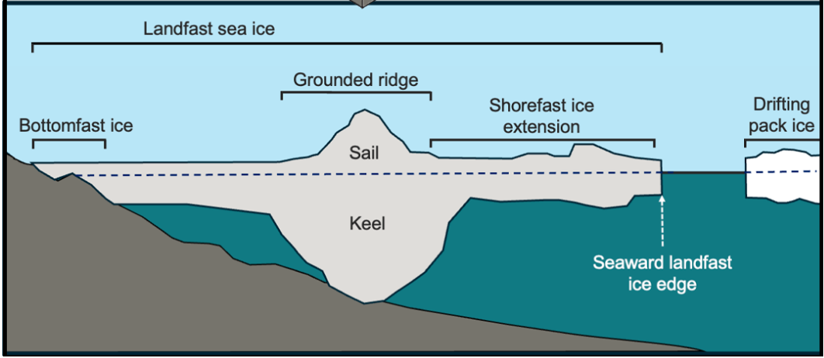
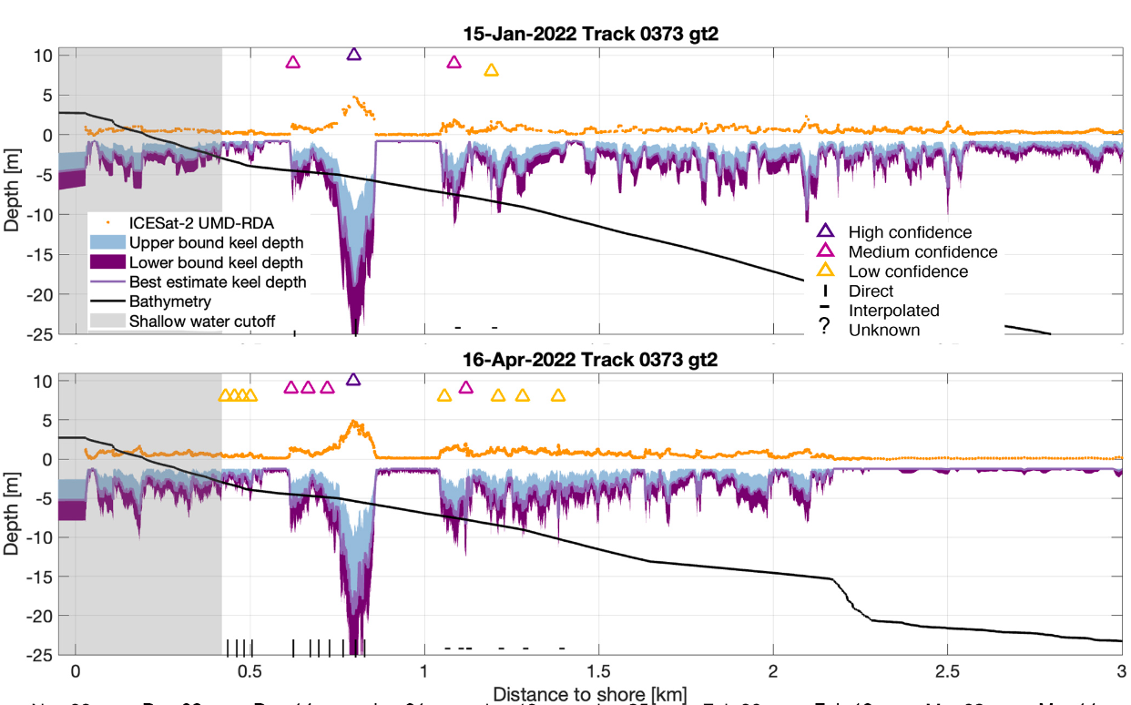
Mapping Grounded Ridges in Coastal Alaska
Landfast ice (ice that is attached to the shore) is used for transportation of goods and services between villages, oil rigs, and provides ocean access.
Grounded ridges anchor ice, providing a stable platform. The protruding portion disrupts transport routes and restricts ocean access.
Surface topography observations from ICESat-2 are used to predict grounded ridge locations.
Improved safety and economic prosperity for those living and working in the polar coastal regions.
Chukchi Sea
Beaufort Sea
Point Barrow
Alaska
from ICESat-2
shallow coastal zone
landfast sea ice
sail
keel
grounded ridges
intercept seafloor
seafloor
Notes:
Source: Lange et al. (2025) https://doi.org/10.5194/tc-19-2045-2025
Studying these grounded ridges is relevant because they stabilize landfast ice + hinder local access to the ocean.
Ice stability depends on 3D structure of ridges.
ICESat-2 → Precise topography of deformed ice, used to identify pressure ridges and measure sail heights.
Coupling ICESat-2 data with empirical relationships based on surveyed ridge geometries we estimate keel depths. Using knowledge of the seafloor bathymetry we can then predict grounded ridge locations.
Kennedy Lange (undergraduate) along with her 3 coauthors developed this innovative study to estimate ridge keel depths and identify grounded ridges in landfast ice along the Alaskan coastline using ICESat-2 data from 1 Dec 2021 to 1 May 2022 (Map, top right).
Ridge cross-section (bottom right) is derived from ICESat-2 and shows the prevalence of deformed ice and grounded ridges in the Chukchi Sea on 16 April 2022 at 71.19°N, 157.04°W
Our approach can be used to monitor grounded ridge formation and improve representation of landfast ice in sea ice models and forecasts.
Landfast ice (attached to the shore) shields the Arctic coastline from storm erosion. It is used for local transportation of goods and services between villages and oil rigs, it provides safe access to the ocean for subsistence hunting and fishing, and it is an important marine mammal habitat.
Grounded ridges have deep keels that anchor ice to the seafloor and thereby provide stability to the ice platform. But their sails disrupt transport routes and can restrict ocean access. They are difficult to monitor since most ice is below the water surface.
We use high-precision ICESat-2 surface topography with empirical relationships from surveyed ridge geometries to estimate keel depths and predict grounded ridge locations.
Our approach can be used to monitor grounded ridge formation and improve representation of landfast ice in sea ice models and forecasts.

