Slide 1

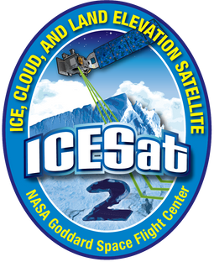

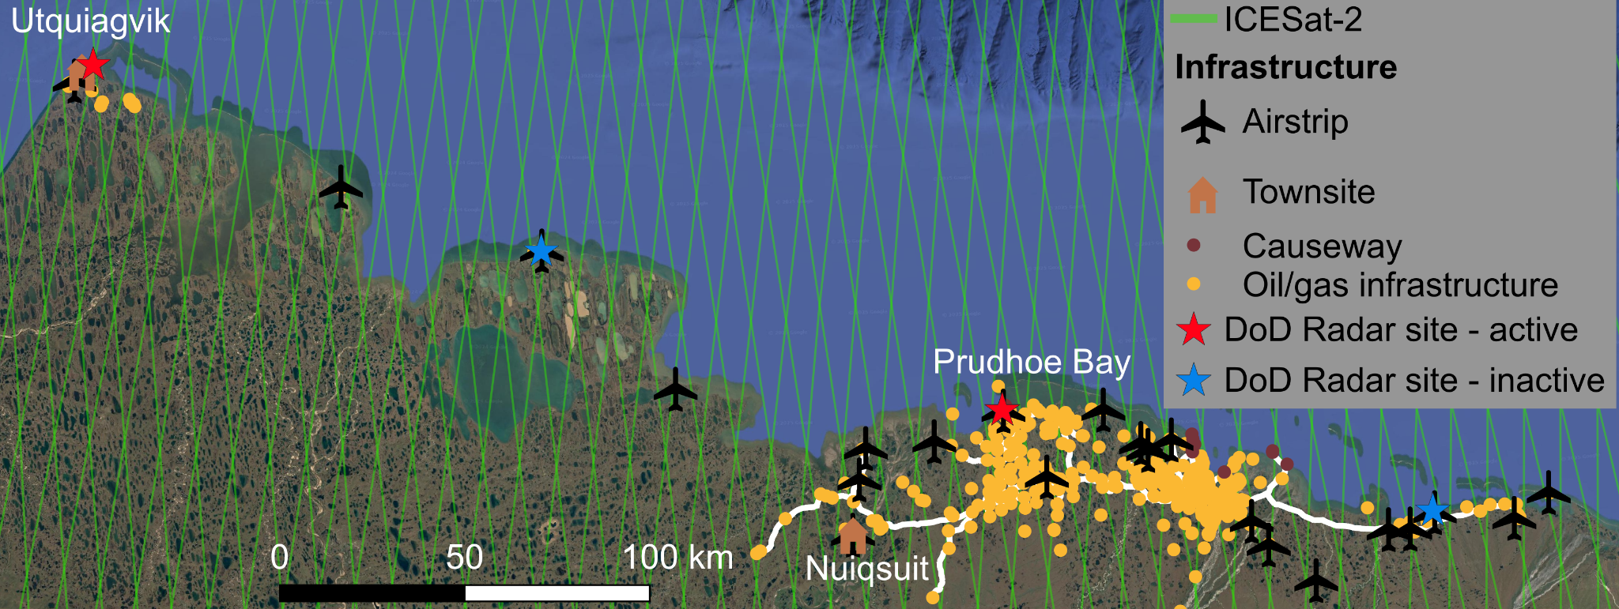


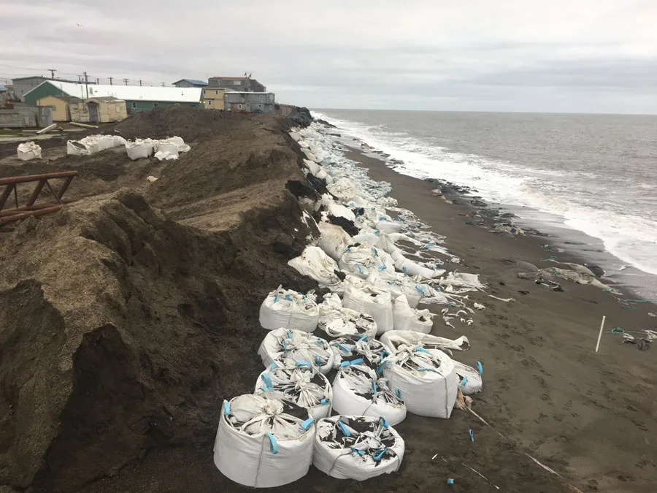
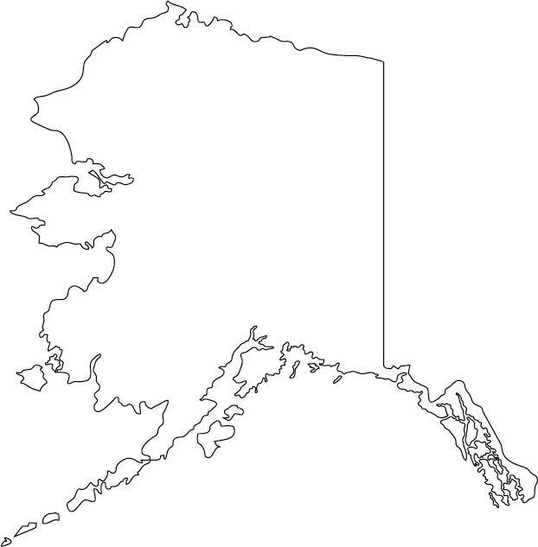
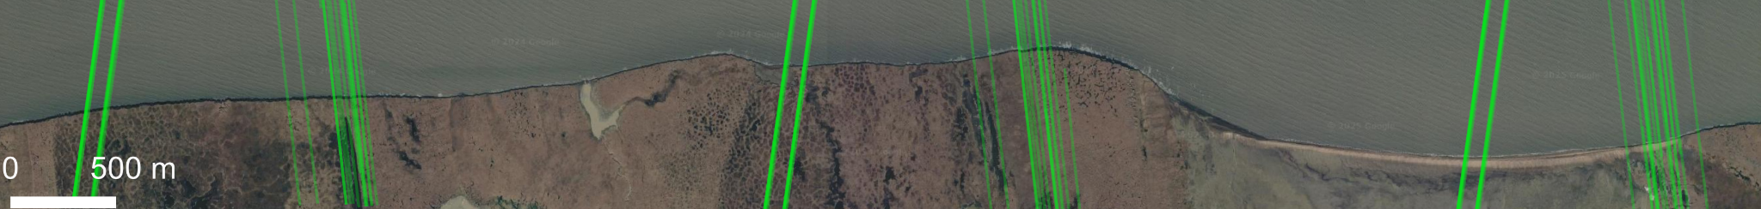
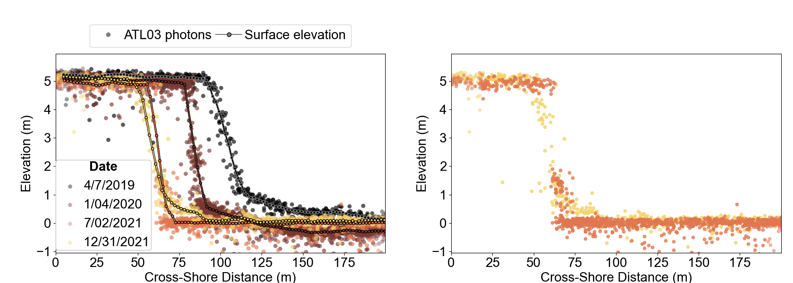
ICESat-2 captures shoreline change along vulnerable Arctic coastlines
Google Earth
© 2025 Landsat/
Copernicus, IBCAO
2
1
  Problem: Permafrost thaw hazards in Alaska including coastal erosion are projected to cost up to $520 million/year in infrastructure damage and community protection and relocation costs over the next few decades
  Solution: ICESat-2 provides high-resolution measurements of shoreline change in remote and rapidly changing parts of Alaska
  Impact: ICESat-2 observations contribute to pan-Alaskan monitoring efforts and can inform models to improve hazard mapping and planning
Photo credit: Louise Farquharson
3
Google Earth
© 2025 CNES/Airbus
4
5
Toppled bluff material visible from photon data
ICESat-2 measures shoreline retreat
Notes:
Figures: 1: an example of an erosion-threatened shoreline in Utqiagvik, Alaska. Sandbags have been placed to protect the coastline. 2: an overview of major infrastructure on the North Slope of Alaska. The Reference ground tracks of ICESat-2 are shown, highlighting the dense coverage of ICESat-2 in this region 3: The area covered by a recent paper (Bryant et. al, 2025) demonstrating ICESat-2’s effectiveness at tracking shoreline change. All ICESat-2 tracks from 2019 to 2021 are shown. Highlighted in red is a ground track with several repeated measurements, which are plotted below. 4: Elevation data from ICESat-2 of 4 repeats of the same ground track over a coastal bluff, illustrating the retreat of the shoreline. The geolocated photon data (ATL03) is shown, as well as elevations profiles derived from ATL03. 5: If we focus on the ATL03 photon data, we see evidence of toppled bluff material, providing evidence of specific erosion mechanisms that are traditionally hard to observe with satellite remote sensing.
Problem/situation: Permafrost thaw-driven hazards, including coastal erosion, are projected to cost up to $420 million/year in public infrastructure maintenance and repair costs in the next 50 years. Threatened infrastructure includes airports, roads, oil infrastructure, municipal infrastructure, and Department of Defense early warning radar sites. While some of these radar sites have already been decommissioned due to erosion threats, their airstrips and landing pads can be used as staging areas for oil and gas exploration, reducing the need to invest in new infrastructure. Coastal erosion also threatens coastal Alsakan communities, with an estimated cost of $100 million per year cost to protect or relocate vulnerable communities. Accurate maps of current erosion rates and projections of future erosion are vital for identifying and protecting at-risk infrastructure, and this requires high resolution, repeat measurements of shoreline change.
Solution: ICESat-2 provides annual to seasonal repeat measurement of shoreline change in remote areas that are hard to survey with airborne methods. A recent paper authored by researchers at the Scripps Institution of Oceanography, Colorado School of Mines, and Washington University in St. Louis estimated shoreline change rates from ICESat-2 and found them to be comparable with those estimated by satellite imagery. Surface elevations were derived from ATL03 geolocated photon data using the SlideRule Client, a web service developed to provide custom processing of ICESat-2 data. In addition to estimating erosion rates, analysis of ICESat-2 elevation profiles shows how the morphology, or shape of the shoreline, changes over time. Small-scale features such as toppled bluff material and surface ponding can also be identified in ATL03 photon data. These observations provide valuable insight on the processes driving local erosion at spatial and temporal scales that have not previously been observed by satellite.
Impact: These observations can be used to validate satellite imagery-based erosion estimates and fill in observational data gaps, helping to identify current hotspots of erosion and determine which shoreline morphologies are the most susceptible to erosion. Elevation profiles generated from ICESat-2 can also be integrated into erosion models to help improve forecasts of future erosion rates. Improved observations and projections can help federal, state, and local agencies determine priorities for reinforcing or relocating threatened infrastructure. It’s been estimated that proactive adaptation of vulnerable infrastructure can reduce repair and replacement costs by up to 45%, saving the government 10s of millions of dollars per year. Agencies that could benefit from this data for monitoring or projecting shoreline change include USGS, USACE and Alaska DGGS.
[1] North Slope Infrastructure (V13): Roads, Pipelines and Developed Areas, North Slope Science Initiative, https://catalog.northslopescience.org/dataset/2663
[2] The DEWLine, https://lswilson.dewlineadventures.com/page4-2/#L
[3] Economic Effects of Climate Change in Alaska: https://journals.ametsoc.org/view/journals/wcas/11/2/wcas-d-18-0056_1.xml
[4] Erosion threat at remote military radars decades ahead of schedule: https://alaskapublic.org/2016/07/04/erosion-threat-at-remote-military-radars-decades-ahead-of-schedule/
[5] The impacts of coastal erosion on Alaska’s North Slope communities: a co-production assessment of land use damages and risks: https://www.tandfonline.com/doi/full/10.1080/1088937X.2020.1755907
[6] Multiple modes of shoreline change along the Alaskan Beaufort Sea observed using ICESat-2 altimetry and satellite imagery, https://tc.copernicus.org/articles/19/1825/2025/
[7] SlideRule,https://slideruleearth.io/web/about/
[8] Estimating future costs for Alaska public infrastructure at risk from climate change, https://www.sciencedirect.com/science/article/abs/pii/S0959378008000216?via%3Dihub#tblfn3b

